Slide 1

DSC 530 Term Project
Dean Winters
Dr. shankar parajulee
11/19/21

Slide 2
Hypothesis/Question
For this project I decided to look at data from global video game sales starting at the date 12/22/16 and prior. I’m curious to know if there is a genre of video games that performs better than others during this timeframe. Does it matter what region? Does it matter what year it was released? Is there a particular publisher that trends better than the others? If so, why might that be?
The data I’ve used is from the csv file “Video_Games_Sales_as_at_22_Dec_2016.csv”

Slide 3
Variables
Here are the variables I’ve chosen to use for my analysis:
Genre – This refers to the specific genre that the game falls under.
Year_of_Release – The year that the game released in.
Publisher – The publishing company for the game.
Global_Sales – The total sales for each game worldwide as of when this data was collected, in millions.
Platform – The hardware console that the game released on.
NA_Sales, EU_Sales, JP_Sales, Other_Sales – These are all subsets of Global_Sales which add up to the global sales total.

Slide 4
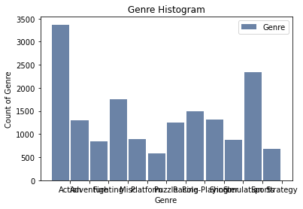
Histograms
Most of the histograms are somewhat difficult to read since thinkplot doesn’t have a way to skew the labels at the bottom, but from what I can make out the biggest genre seems to be Action while the smallest genre is Puzzle. I think all data points should be included in this set since there are no outliers.
Other descriptive characteristics:
Mean: N/A
Mode: Action
Spread: N/A
Tail: N/A

Slide 5
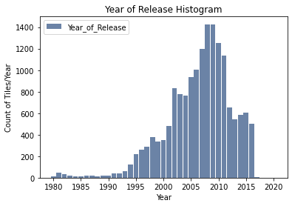
Histograms Cont.
For year of release, the years start to pick up around 1994 when I would assume more companies had access to better technology and personnel to actually make the games rather than a few companies. I don’t really consider any of these outliers since none of them are that far away from the main distribution.
Other descriptive characteristics:
Mean: 2006.49
Mode: 2008
Spread: 34.5626
Tail: Skewed to the left

Slide 6
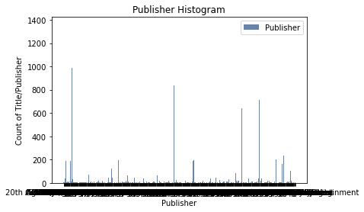
Histograms Cont.
This one is very hard to view, but there are 4 major outliers of companies who put titles out far more than any of the others. These should be included since they hold so many titles to them and removing them would paint a very different picture of the data.
Other descriptive characteristics:
Mean: N/A
Mode: Electronic Arts
Spread: N/A
Tail: N/A

Slide 7
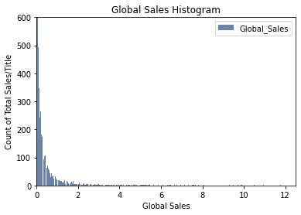
Histograms Cont.
Global sales has one major outlier being Wii Sports. Wii sports is so far above any of the other titles that it makes it impossible to really view any of the data. Even when cutting the xlim down to 12.5, It’s still very hard to view the results since 1000s of titles do very poorly compared to the few rockstar titles.
Other descriptive characteristics:
Mean: 0.53 – in millions
Mode: 0.02 – in millions
Spread: 2.3961
Tail: Skews to the right due to large outliers

Slide 8
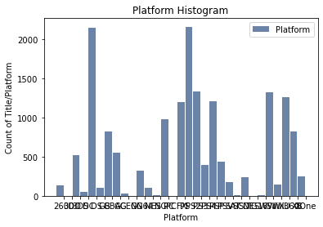
Histograms Cont.
The platform histogram is also very difficult to read since the labels overlap each other in thinkplot. There are a couple platforms that do very well and a few that have very few titles on them.
Other descriptive characteristics:
Mean: N/A
Mode: PS2 – PlayStation 2
Spread: N/A
Tail: N/A

Slide 9
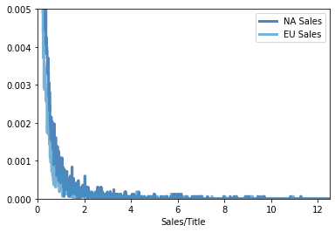
PMFs
Comparing the sales in North America to the sales in Europe, North America tends to have a higher probability than Europe. Some of the higher selling titles look to have a higher probability in Europe than North America, but almost all of the lower-performing titles do better in North America. The example shown is zoomed in very far to see any sort of difference between the two groups.

Slide 10
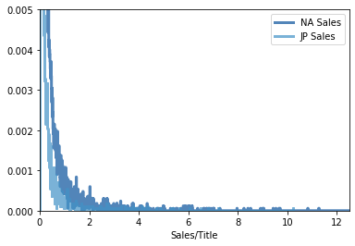
PMFs Cont.
When comparing Japan sales to North America, North America does even better than it did to the Europe sales. These discrepancies could be due to overall population size when comparing North America to the other regions.

Slide 11
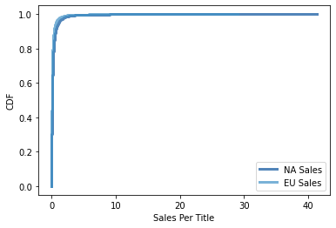
CDF
This CDF tells me that when comparing NA sales to EU sales, the vast majority of around 98% of titles sell only 0.5 million units while the final 2% make up the remaining sales. Any idea of getting into the video game developing business to make it big and collect easy money can go right out the window from looking at this. Only a few select titles make it to the extremely successful area.

Slide 12
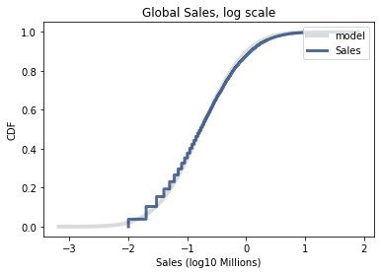
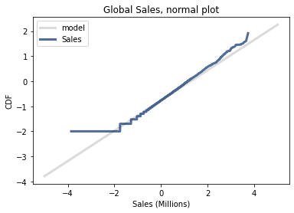
Analytical Distribution
I did a lognormal distribution of Global_Sales and it fits the data pretty well. When looking at the normal probability plot, the data breaks off near the tails, but for the most part it stays with the model.

Slide 13
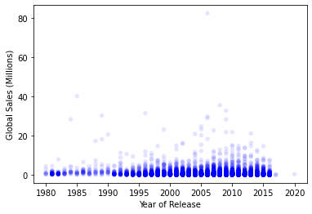
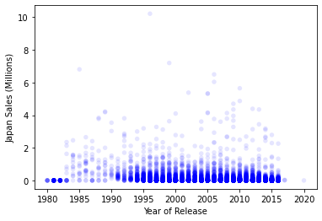
Scatter Plots
Unfortunately, I could only compare in scatter plots between the sales data and the year of release, so I wanted to see if there was any different between the total sales and sales in Japan. Overall, there is a very slight positive correlation between the year of release and sales, but I think that’s more due to the sheer volume of games being created and their popularity as the years go on, rather than games selling more.

Slide 14
Hypothesis Test
For this section I conducted a permutation test, but the results I received were 0.0 every time. I tried using a few different methods, but either my data doesn’t work correctly with the thinkstats methods showcased, or I simply don’t understand this material well enough and would like to explore it further. Conducting a hypothesis test in Python is considerably different from conducting one by hand/calculator on paper.

Slide 15
Regression Analysis
There’s too much to copy over into the slide deck from the regression analysis, but it’s in the Jupyter notebook. I compared global sales related to genre. The only set that was statistically significant is the Role-Playing genre.

